Slide 1
Web Application Security Code Pitfalls Training 2022

Slide 2
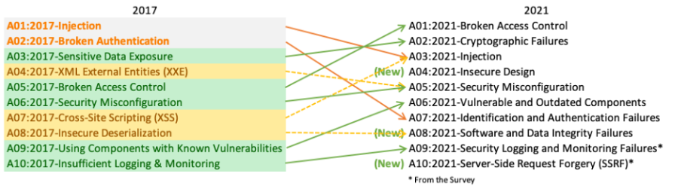
OWASP 2022
Focusing on OWASP 1, 3, 5, 10

Slide 3
Broken Access Control
Cross-Site Scripting (XSS)
DOM-Based XSS
Cross-Site Request Forgery

Slide 4
Cross-Site Scripting (XSS)
Type of injection where executing malicious scripts to output information from the website
Output information such as other user’s accounts
Example:
Displays an alert with “Ha Ha Ha”

Slide 5
XSS Potential Usage
An attacker able to:
Impersonate or masquerade as the victim
Carry out any action that the victim is able to perform
Read any data that the victim is able to access
Capture the user’s login credentials
Perform virtual defacement of the website
Inject trojan functionality into the website

Slide 6
XSS Prevention
Encode data on output, example:
HTML:
“<” converts to “&lt;”
“>” converts to “&gt;”
JavaScript:
“<” converts to “\u003c”
“>” converts to “\u003e”
Validate input on arrival, example:
If a user submits a URL that will be returned in responses, validate that it starts with HTTP and HTTPS
Validate the value is an integer, if the user supplies a value that is expected to be numeric

Slide 7
DOM-Based XSS
Where the attack payload is executed as a result of modifying the Document Object Model (DOM) environment in the victim’s browser so that the client side code runs in an unexpected manner
To deliver, need to have source and a sink
Source: injection point of the malicious script, exists on the client
Example: document.URL, cookies, referrer header
Sink: reflection point that executes (or helps with execution of) the malicious scripts injected through the source, exists on the DOM or Browser Object
Example: eval(), document.write, setTimeout

Slide 8
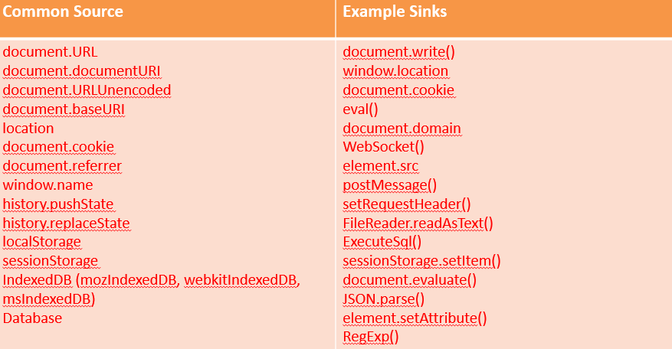
DOM-Based XSS Source and Sink

Slide 9
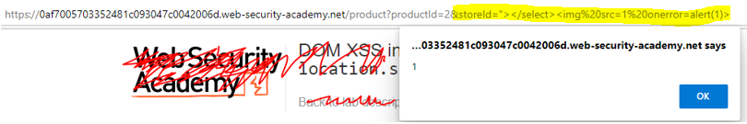
DOM-Based XSS Examples
Adding the XSS to the URL displayed an alert with a “1” at the store page
The attacker will be able to get the value of variable “x” and display it on the output which is opened by document.open()

Slide 10
DOM-Based XSS Prevention
Use the right output method (sink)
Example:
Use innerText or textContent instead of innerHtml to use user input in a div tag
Untrusted data should only be treated a displayable text
Or only on the right side of an expression
Always JavaScript encode and delimit untrusted data as quoted strings when entering the application when building templated JavaScript
Example:

Slide 11
DOM-Based XSS Prevention
Use document.createElement("..."), element.setAttribute("...","value"), element.appendChild(...) and similar to build dynamic interfaces
Limit access to object properties when using object[x] accessors
Example:
The attacker could use to subvert internal and external attributes of the “myMapType” object
Better approach:

Slide 12
XSS Practical
https://xss.challenge.training.hacq.me/
Notes:
<script>alert(/xss/)</script>

Slide 13
Session Authentication
A session is a JSON file that stores information about the user, such as unique ID, time of login and expirations
Generated and stored on the server to keep track of user requests
User might be able to receive some of the details with the request

Slide 14
Session Authentication cont.
The user sends a login request to the server.
The server authenticates the login request, sends a session to the database, and returns a cookie containing the session ID to the user.
Now, the user sends new requests (with a cookie).
The server checks in the database for the ID found in the cookie, if the ID is found it sends the requested pages to the user.

Slide 15
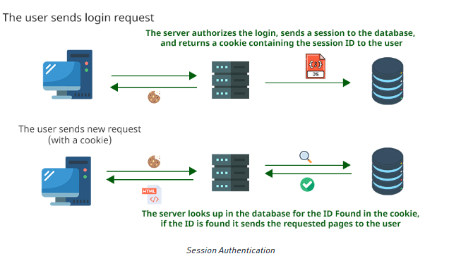
Session Authentication cont.

Slide 16
Session Cookies
Contains data that the server sends to the browser for temporary use
Able to store login information, and send to all subdomains, so the user only needs to login once
Example:
www.example.com
Set-Cookie: session=89bea4bb-85d1-4f8b-b4fa-a9b8db015e2b; Max-Age=2600000; Domain=example.com; Path=/; Secure; HttpOnly
Session – Globally Unique Identifier (GUID)
shop.example.com will also be able to use Session

Slide 17
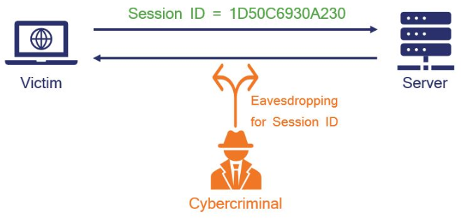
Session Hijacking Attack
Attacker can do anything that the original user is authorized to do by getting the Session ID
Such as purchasing items, accessing detailed personal information & company data, and launch ransomware attack

Slide 18
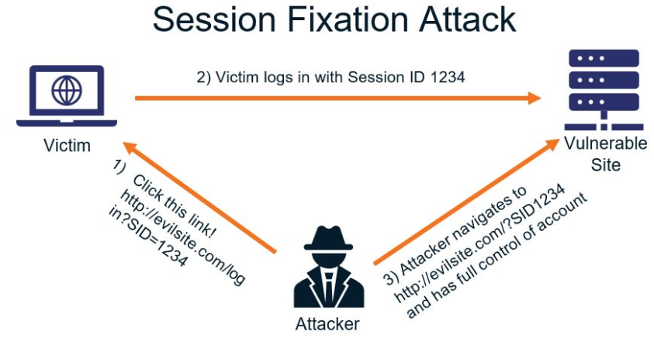
Session Hijacking Attack Methods
Session Fixation
Relies on website accepting Session IDs from URLs, most often via phishing
Session Sniffing
Attacker uses packet sniffer, such as WireShark, to intercept and log packets as they flow across a network connection
Attackers will then steal the session cookies in the log packets

Slide 19
Session Hijacking Prevention
Use HTTPS and SSL/TLS on entire site to encrypt all traffic parsed between parties
Use the secure cookie flag
Use long and random Session ID
Regenerate Session ID after login
Time-out Inactive Sessions
Do not accept Session IDs from GET/POST

Slide 20
Token-based Authentication
Token is an authorization file that cannot be tampered with
Generated by the server using a secret key, sent to and stored by the user in the local storage
User will send the token to the server with every new request, for the server to verify the signature and authorize requests

Slide 21
Token-based Authentication cont.
The user sends a login request to the server.
The server authorizes the login and sends a token to the user.
Now, the user sends a new request(with a token).
The server checks the token is valid or not, if the token is valid it sends the requested pages to the user.

Slide 22
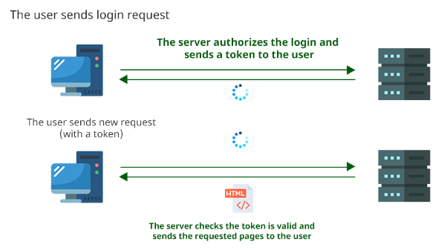
Token-based Authentication cont.

Slide 23
JSON Web Token (JWT)
Standardized format for sending cryptographically signed JSON data between systems
Used to send information about users as part of authentication, session handling and access control mechanisms
All the data a server needs is stored client-side within the JWT

Slide 24
JSON Web Token (JWT) cont.
Consists of header, payload and signature
Separated by a dot
Example:
https://jwt.io/ to decode

Slide 25
JSON Web Token (JWT) attack
User can send modified JWT to the server to achieve malicious goal
Usually to bypass authentication and access controls by impersonation
How does attacks arise?
Signature of JWT is not verified properly
Accepting tokens with no signature

Slide 26
Exploiting JWT signature verification
Example:
If server identifies the session based on “username”, modifying the value might enable attackers to impersonate other logged-in users
Same with “isAdmin”

Slide 27
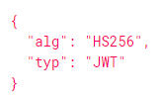
Accepting tokens with no signature
JWT header contains “alg” parameter:
Changing “alg” header to “none” and removing signature
Attacker can directly influence how the server checks whether the token is trustworthy

Slide 28
JWT changing header attack
https://github.com/Sjord/jwtdemo
HS256 page

Slide 29
JWT attack prevention
Use up to date library for handling JWTs
Set an expiration date for any tokens issued
Avoid sending tokens in URL parameters where possible
Enable the issuing server to revoke tokens
Example “on logout”

Slide 30
Cross-Site Request Forgery (CSRF)
Tricks the victim into loading a page that is not supposed to load
Can make the victim perform actions that they didn’t intend to, such as logout and purchase item
Example:
Tricks the victim by rendering an image which issues a request to the “mybank.com” to transfer funds page with the specified parameters

Slide 31
CSRF Prevention
Use SameSite cookies
Used to control whether and how cookies are submitted in cross-site requests
Strict behaviour:
Browser will not include the cookie in any requests that originate from another site (1st party)
Most defensive but will impair user experience, will not remember if a user has logged in to a website and requires to log in again
Lax behaviour:
cookie in requests that originate from another site but only if two conditions are met:
The request uses the GET method. Requests with other methods, such as POST, will not include the cookie.
The request resulted from a top-level navigation by the user, such as clicking a link. Other requests, such as those initiated by scripts, will not include the cookie
Provides partial defence

Slide 32
Injection
Blind SQL
UNION attack
SQL injection prevention

Slide 33
Blind SQL
When an application is vulnerable to SQL injection, but its HTTP responses do not contain the results of the relevant SQL query or the details of any database errors
Do not rely on being able to see the results of the injected query within the application’s responses
Exploitation example:
Will return the results of xyz if the password is greater than m
Where m is the length of the password
Can change the value of m to find out the length of the password

Slide 34
UNION attack
UNION combines the result-set of 2 or more SELECT statements:
Returns a single set query with 2, containing values from columns “a” and “b” in “table1” and columns “c” and “d” in “table2”
Requirement for UNION query:
Individual queries must return the same number of columns
the data types in each column must be compatible between the individual queries

Slide 35
UNION attack (cont.)
Finding out how many columns are being returned:
ORDER BY:
Specified by index, if the index exceeds the actual column, it will return error:
UNION SELECT:
If the number of null does not match the number of columns, it will return error:
Or might return different generic error or no results
When the number of NULLS matches the number of columns, the database returns an additional row in the result set, containing NULL values in each column
Not really an effective method to determine the column count

Slide 36
UNION attack Example
Retrieving interesting data (exploitation) :
Assuming:
The original query returns 2 columns, both holding string data
Injection point is a quoted string within the WHERE clause
The database contains a table called “users” with the columns “username” and “password”
The database retrieves the contents of “users” table:
The database retrieves the contents of “username” and “password” of “users” table in a single column:
Results:

Slide 37
SQL injection prevention
Using PreparedStatement to prevent user input from interfering with the query structure:

Slide 38
UNION attack Practical
https://www.hacksplaining.com/exercises/sql-injection
To complete, follow instructions

Slide 39
Security Misconfiguration
XML External Entity (XXE) injection
Exploiting XXE to retrieve files
Exploiting XXE to perform SSRF attacks
XXE prevention

Slide 40
XML External Entity (XXE) injection
Allows an attacker to interfere with an application’s processing of XML data
Allows the attacker to view files and interact with back-end or external systems that the application can access
Types of XXE attacks:
Exploiting XXE to retrieve files
Exploiting XXE to perform SSRF attacks
Exploiting blind XXE exfiltrate data out-of-band
Exploiting blind XXE to retrieve data via error messages

Slide 41
Exploiting XXE to retrieve files
Need to modify the submitted XML in 2 ways:
Introduce (or edit) a DOCTYPE element that defines an external entity containing the path to the file
Edit a data value in the XML that is returned in the application’s response, to make use of the defined external entity
Example:
Suppose a shopping application checks for the stock level of a product by submitting the following XML to the server:
Can exploit XXE vulnerability to retrieve /etc/passwd/ file by submitting the XXE payload:
Which will provide the results:

Slide 42
Exploiting XXE to perform SSRF attacks
Need to define an external XML entity using the targeted URL and use the defined entity within a data value
Example:
Causing the server to make a back-end HTTP request to an internal system within the organisation’s infrastructure:

Slide 43
XXE Prevention
Disable features that supports XML parsing library that the application does not need or intend to use
Disable resolution of external entities and disable support for XInclude

Slide 44
Server-Side Request Forgery (SSRF)
SSRF attack against the server itself
SSRF against other back-end systems
SSRF Prevention

Slide 45
Server-Side Request Forgery (SSRF)
Allows the attacker to induce the server-side application to make requests to an unintended location or perform arbitrary command execution
Might cause the server to make a connection to internal-only services within the organisation’s infrastructure
Maybe be able to force the server to connect to arbitrary external systems, potentially leaking sensitive data

Slide 46
SSRF attack against the server itself
Attacker induces the application to make a HTTP request back to the server who is hosting the application, via its loopback network interface
Example:
A shopping application lets the user view an item that is in stock, the application must query various back-end REST APIs
The function is implemented by passing the URL to the relevant back-end API endpoint via a front-end HTTP request:
The attacker can modify the request to specify a URL local to the server itself:
The server will fetch the contents of the /admin URL and return it to the user
The request /admin URL comes from the local machine itself and the normal access controls are bypassed, granting full admin functionality

Slide 47
SSRF against other back-end systems
When the application server is able to interact with other back-end systems that are not directly reachable by users
Example:
Suppose there is an administrative interface at the back-end URL
https://192.168.0.68/admin
Can access the administrative interface by submitting this request:

Slide 48
SSRF Prevention
Blacklist-based input filters
Block input containing hostnames like 127.0.0.1 and localhost
Use alternative IP representation of 127.0.0.1 such as 2130706433, 017700000001, or 127.1
Or use own domain names that resolves to 127.0.0.1
Whitelist-based input filters
Whitelist the hostname (DNS name) or IP address that the application needs to access
Allow only specific URL schemas, http:// , https://
Does not allow attackers to use file:// , ftp://
Authentication on internal services

Slide 49
Insecure Deserialization
Serialization is the process of converting complex data structures that can be sent and received as a sequential stream of bytes
Insecure deserialization is when user-controlled data is deserialized by a website
Allows attackers to manipulate serialized objects in order to pass harmful data into the application code

Slide 50
Insecure Deserialization Exploitation
Manipulating serialized objects
Modifying object attributes
Modifying data types

Slide 51
Modifying object attributes
Example:
Website uses serialized User object to store data about a user’s session in a cookie:
“isAdmin” can be changed to 1 instead of 0 then re-encode the object and overwrite the current cookie

Slide 52
Modifying object attributes
Due to PHP’s loose comparison operator,
5 == "5" evaluates to true
Due to PHP converting the string to and integer based on the initial number
5 == "5 of something" is treated as 5 == 5
0 == "Example string" // true
Due to PHP treating the entire string as the integer 0

Slide 53
Modifying object attributes cont.
Attackers can use this vulnerability in conjunction with user-controllable data from a deserialized object
Example:
Attacker can modify the password attribute to contain integer 0, returning “True”, bypassing authentication

Slide 54
Insecure deserialization prevention
Avoid using generic deserialization features as it contains all attributes of the original object
Create class-specific serialization methods to control the exposed fields
Sanitise user input
Whitelist user input to restrict allowed content
Escape characters using Apache Commons Lang library
Avoid deserialization of user input if possible
Incorporate robust measures to make sure the data is not tampered with
Implement digital signature to check integrity of the data
Checks needs to take place before beginning the deserialization process

Slide 55
Insecure Design
Broad category representing different weaknesses
Focusing on Secure Design, that evaluates threats and ensures that code is designed and tested to prevent known attack methods
External Control of File Name or Path
Plaintext Storage of a password
Improper Privilege Management
Missing Encryption of Sensitive Data

Slide 56
External Control of File Name or Path
The code uses input from HTTP request to create a file name.
Attacker could provide filename such as “../../tomcat/conf/server.xml”, which causes the application to delete one of its own configuration files.

Slide 57
Plaintext Storage of a password
The code reads a password from the registry and uses it to create a new network credential.
Anyone who has access to the registry key used to store the password can read the value of the password.

Slide 58
Improper Privilege Management
The code temporarily raises the program’s privileges to allow creation of a new user folder.
If the os.mkdir() throws an exception, lowerPrivileges() will not occur, making the program to raise the privilege of the user.

Slide 59
Missing Encryption of Sensitive Data
The code writes a user’s login information to a cookie so the user does not have to login again later.
The code stores the information in plaintext in a cookie on the user’s machine which exposes the information if it is compromised by an attacker.
Even if it is not compromised, this can be paired with ZSS and allows the attacker to remotely copy the cookie.

Slide 60
Link to Quiz
https://my.forms.app/form/63984c5174e3801d7f81971c
Good luck ☺
Notes:
https://my.forms.app/form/63984c5174e3801d7f81971c

